Slide 1
FAKE NEWS DETECTION
Team Members:
Asha Latha Nama
Harshini Badam
Rushith Kumar Challa
Sai Subash
Sathwik Vattikutti

Slide 2
ABSTRACT
Social media is on high rise in the recent world and there are many pros and cons to its utilization. As users can post anything on social media without any consent, the spread of fake news has become one of the most challenging problems. Fake news content has the potential to make some serious issues in society. Although it is a problem for many decades spreading fake news has increased with the recent rise of social media in recent years. In this survey, we are using two different datasets to analyze how LDA and BERTopic work in topic modeling and compare the topics from each model. Also, to develop a model with supervised learning, we are using the python libraries Scikit-Learn, Pandas, NumPy, and NLP for textual analysis to explore machine learning models.

Slide 3
INTRODUCTION
Internet is one of the most significant innovations of all time and people use it for various reasons. One of which is social media in which people post various news.
These platforms do not verify the posts and spread false information very rapidly which will have an impact on people, businesses, or political parties.
Though these online platforms are beneficial for users, it gives an opportunity for cyber criminals to spread fake news using these sites.
Separating a piece of news as real or fake and categorizing news like entertainment or politics etc, are the challenges that can be predicted using machine learning algorithms.

Slide 4
DATASET
In this project we have considered two datasets from the Kaggle website for our purpose and performed some machine-learning techniques on these datasets.
The attributes of the first dataset are:
Id : There is a unique id assigned for each news article.
Title: Title of the article published
Text: a short description of the article
Label: Contains whether the article is Real or Fake

Slide 5
The attributes of the second dataset are:
category: category of the news
headline: the headline of the news
authors: list of authors who contributed
link: link to the original news.
short_description: Information about the news
date: publication date

Slide 6
Steps selected to achieve results:
LDA Topic modeling
BERTopic
Dynamic BERT
Machine learning model training and verification

Slide 7
Methodology:
Step 1: Loaded the dataset into variable data with read_csv.
Step 2: Checked for null values, removed duplicates and performed stemming (reducing words to their root form)
Step 3: Removed stop words
Step 4: We have applied LDA topic modeling to the datasets to analyze the topics from the model.
The drawback with LDA is labeling the output clusters has to be performed manually based on the topics that we achieved and cannot verify if the assigned topic is right or wrong.
To Evaluate this, we have adopted BERTopic to compare and analyze the topics from its clusters.
Step 5: We have applied BERTopic on the data set with sentence embeddings

Slide 8
Step6: After applying BERTopic, we get the different topics with their count. Using the get_topic() method we can see the words and the respective frequencies of the topic.
Step7: For both the LDA and BERTopic, we have visualized the words using word cloud.
Step8: We have applied our models, passive aggressive classifier and logistic regression on our training and testing datasets splitted into 80 and 20% respectively.
Step9: Using the dynamic bert, we are visualizing how topics are changed over time and this can be applied for the dataset which has date column.

Slide 9
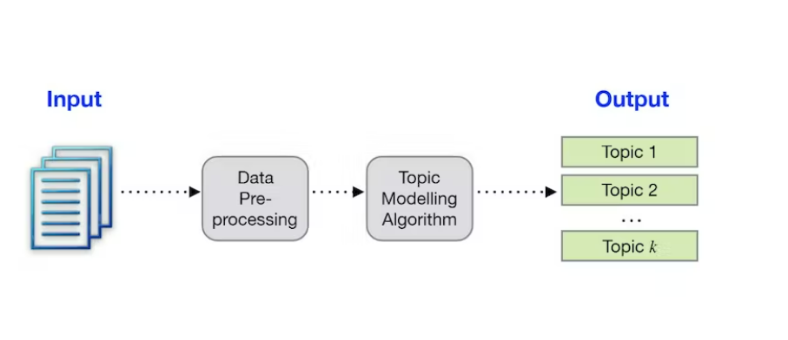
Topic Modeling:
Topic modeling is an unsupervised machine-learning model that sorts different documents data into topics.
With the increase of online networking platforms, vast amounts of data are generated daily in different forms. Due to this, it is very difficult in finding useful information from all the data.
There are some machine learning and NLP algorithms available to analyze the textual data which also includes topic modeling which is very much popular in recent years.

Slide 10
LDA Topic Modeling:
LDA is an unsupervised machine learning model which is mainly used for topic modeling purposes.
It is one of the popular topic modeling techniques to extract topics from a large corpus of data by generating probabilities of the words which then form into categories.
It is effective for locating relatively accurate topics in the set of documents or bags of words.

Slide 11
BERTopic
BERTopic is a topic modeling technique that transforms(BERT embeddings) to generate topic clusters that can be used to visualize the topics.
It extracts document embeddings with bert, by default it uses sentence transformers trained specifically for semantic similarity tasks and reduces the dimensionality of embeddings to create similar clusters.
Then it extracts the topics into similar clusters which we can analyze with visualisation.

Slide 12
Dynamic BERT
After analyzing the topics with bert, using the dynamic bert it helps to evaluate the topics over time which allows analyzing how a topic is represented in different timestamps. With no need to generate clusters from embeddings because they were already created, this will lead to a distinct topic representation at each timestep.
The dynamic bert will be more interpretable if it is represented visually in how topics are changed over time, where the topics and the date or time of that topic are considered for the visualization.

Slide 13
Logistic regression:
It is a supervised classification algorithm where it is used for predicting a categorical variable, where it calculates a probability of an event. The dependent variable contains discrete values.
We cannot use linear regression for discrete values, it doesn’t classify the data correctly, if there are outliers in the data and logistic regression removes these disturbing outliers using the sigmoid function.
Logistic regression has 3 types i.e., binary, multinomial and ordinal. This type of regression can be used to classify if we have the target variable as the binary value 0 or 1 types.
To predict the continuous values linear regression will be more helpful. The loss function of logistic regression can be calculated using the maximum likelihood estimation.

Slide 14
Passive Aggressive Classifier:
It is a type of machine learning and a high-level algorithm, one of the categories of machine learning algorithms, as supervised and unsupervised algorithms, there is another category in this machine learning algorithm i.e., online learning algorithm.
In this algorithm, we train a model incrementally in the form of small groups of data called mini-batches. It is useful in situations where there is a huge amount of data, training the total data will computationally take a lot of time. Every time new data is added, it continues to learn and updates the model.
It does not require any learning rate. In the passive-aggressive classifier, passive means, if the prediction is correct, there is no need to make any changes and the data is perfect, aggressive indicates that if the prediction is incorrect, changes are required for the model.
The online learning algorithm can be used in the real world for detecting fake news in social media, where every time new data adds, it can easily learn and update.

Slide 15
Results and Conclusion
When compared the results of LDA and BERTopic, we concluded that bertopic is giving more topics and BERTopic is a well performed model for the topic modeling in the real life.
For predicting whether the news is “fake” or “Real”, we have used PassiveAggressiveClassifier which is 92% accurate and also used LogisticRegression which acquired an accuracy of 90%
Thus from the observations we can conclude, that PassiveAggressiveClassifier is best for fake news detection.

Slide 16
Thank You

